Slide 1

Speech emotion recognition

Slide 2
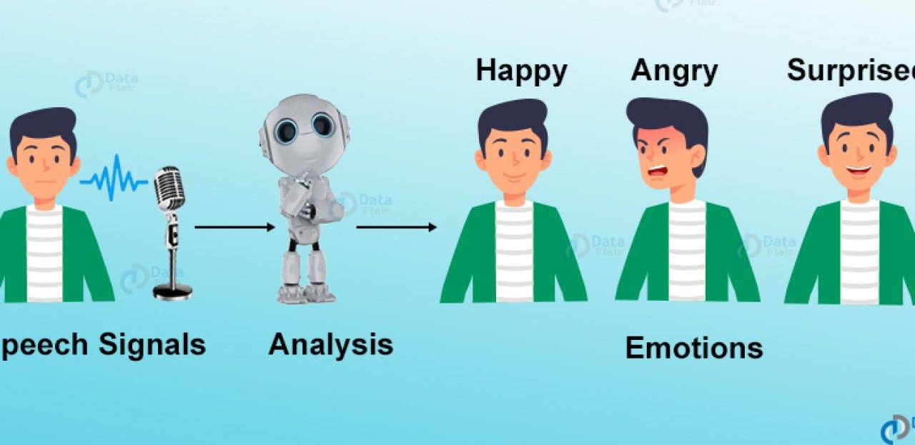
under the guidance of:
sai satish sir, ceo of Indian servers company,
machine learning-batch-04,
g . Bhuvana Sathwika,
kopparapu . lohitha
batch-100

Slide 3

Content
What is speech emotion recognition?
What is librosa?
Data Set
Variation in energy across emotions
Data distribution
Conclusion and future scope
Result

Slide 4
What is Speech Emotion Recognition?
Speech Emotion Recognition, abbreviated as SER, is the act of attempting to recognize human emotion and affective states from speech. This is capitalizing on the fact that voice often reflects underlying emotion through tone and pitch. This is also the phenomenon that animals like dogs and horses employ to be able to understand human emotion.
SER is tough because emotions are subjective and annotating audio is challenging.

Slide 5
What is librosa? librosa is a Python library for analyzing audio and music. It has a flatter package layout, standardizes interfaces and names, backwards compatibility, modular functions, and readable code.
Speech Emotion Recognition – Objective
To build a model to recognize emotion from speech using the librosa and sklearn libraries and the dataset used is tess:- Toronto-emotional-speech-set.

Slide 6
The Dataset
For this Python mini project, we’ll use the TESS dataset; this is the Toronto emotional speech set, and is free to download.
There are a set of 200 target words were spoken in the carrier phrase "Say the word _' by two actresses (aged 26 and 64 years) and recordings were made of the set portraying each of seven emotions (anger, disgust, fear, happiness, pleasant surprise, sadness, and neutral). There are 2800 data points (audio files) in total.
The dataset is organised such that each of the two female actor and their emotions are contain within its own folder. And within that, all 200 target words audio file can be found. The format of the audio file is a WAV format.

Slide 7
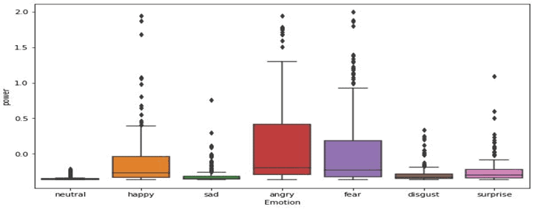
Variation in Energy Across Emotions

Slide 8
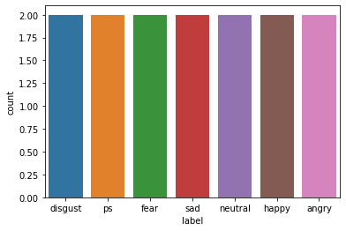
Data Distribution

Slide 9
Conclusions and Future Scope
Through this project, we showed how we can leverage Machine learning to obtain the underlying emotion from speech audio data and some insights on the human expression of emotion through voice. This system can be employed in a variety of setups like Call Centre for complaints or marketing, in voice-based virtual assistants or chatbots, in linguistic research, etc.

Slide 10
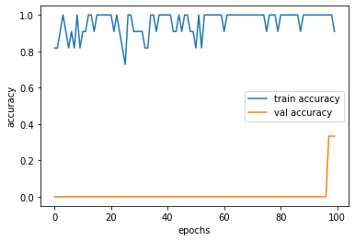
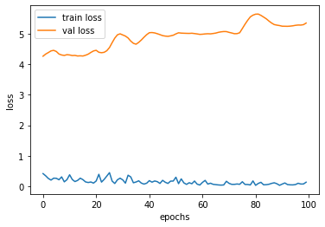
Results
For CNN the accuracy increased with number of epoch .
Similarly, loss decreased with each epoch.
We then increased epoch to 100 and got accuracy around 90%.

Slide 11

Thank you

